Slide 1

Automated Plant Caretaker
Andrew Gonzalez
Ben Wagner
Cade Wildes
EGG1040 | Group Design Project | Group 5

Slide 2
Design Requirements
Problem statement:
Many plants receive improper watering & care due to negligence, lack of knowledge, and lack of time.
Requirements:
Reservoir Size 0.5L+ - This allows even plants that need large quantities of water to survive for a few days.
Only user input is refilling water - Minimizes the amount of work put in by the user.
Adjustable Flow Rate - Variable depending on what type of plant it is and how much water it needs.
Able to last a year without maintenance - Means the user won’t have to waste time repairing the machine.
Soil moisture detection - Allows the machine to adjust watering amount based on the amount of moisture in the soil.
Last 1 week without refill - If the reservoir needs to be refilled too often, it could end up being more difficult than simply watering the plant manually.

Slide 3
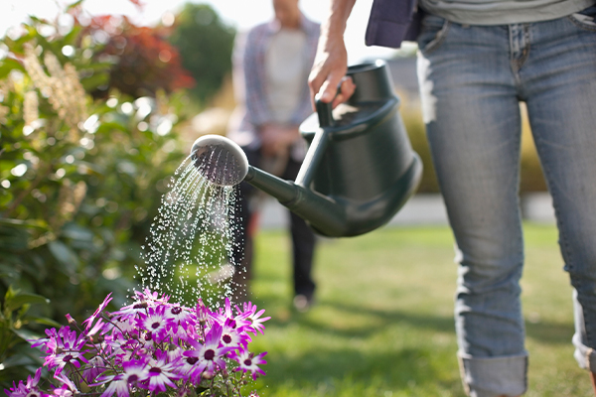
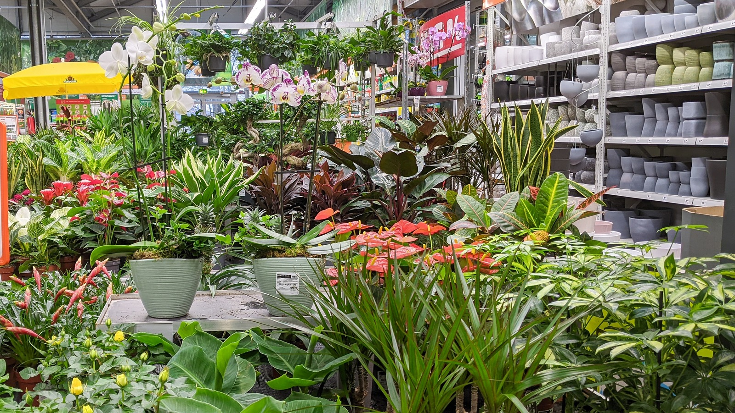
Stakeholders
Main Stakeholders
People traveling for work
People physically unable to perform tasks due to disabilities
People who trouble to remember to keep up with plant care
Retail companies who have large amounts of plants

Slide 4
Initial Concepts
CONCEPT ONE:
A mechanically operated watering device making use of a metal clip to hand device and water tubing to deliver water to the plant.
CONCEPT TWO:
Battery powered pump based design that automatically waters the plant.
CONCEPT THREE:
Solar powered pump design to increase battery life for the automatic waterer.
FINAL CONCEPT:
A combination of the 3, battery operated automatic waterer with the addition of a moisture sensor to detect whether or not the plant needs water.

Slide 5
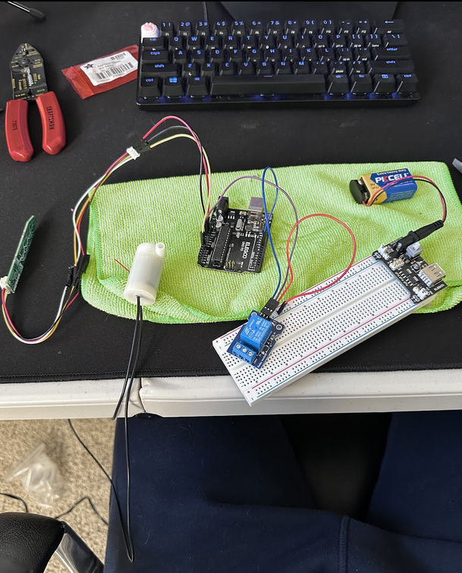
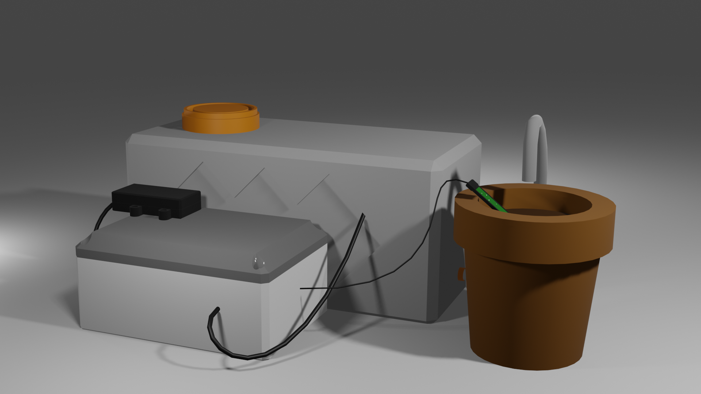
Prototyping
Original Design
Solar panel to charge external battery source, which powers water pump placed in reservoir
Controlled by Raspberry Pi 4
Stored in watertight container
1L reservoir
Adjustments
Budgeting reasons caused us to switch to a 9V battery as our power source
Added relay to protect against excessive current flow

Slide 6
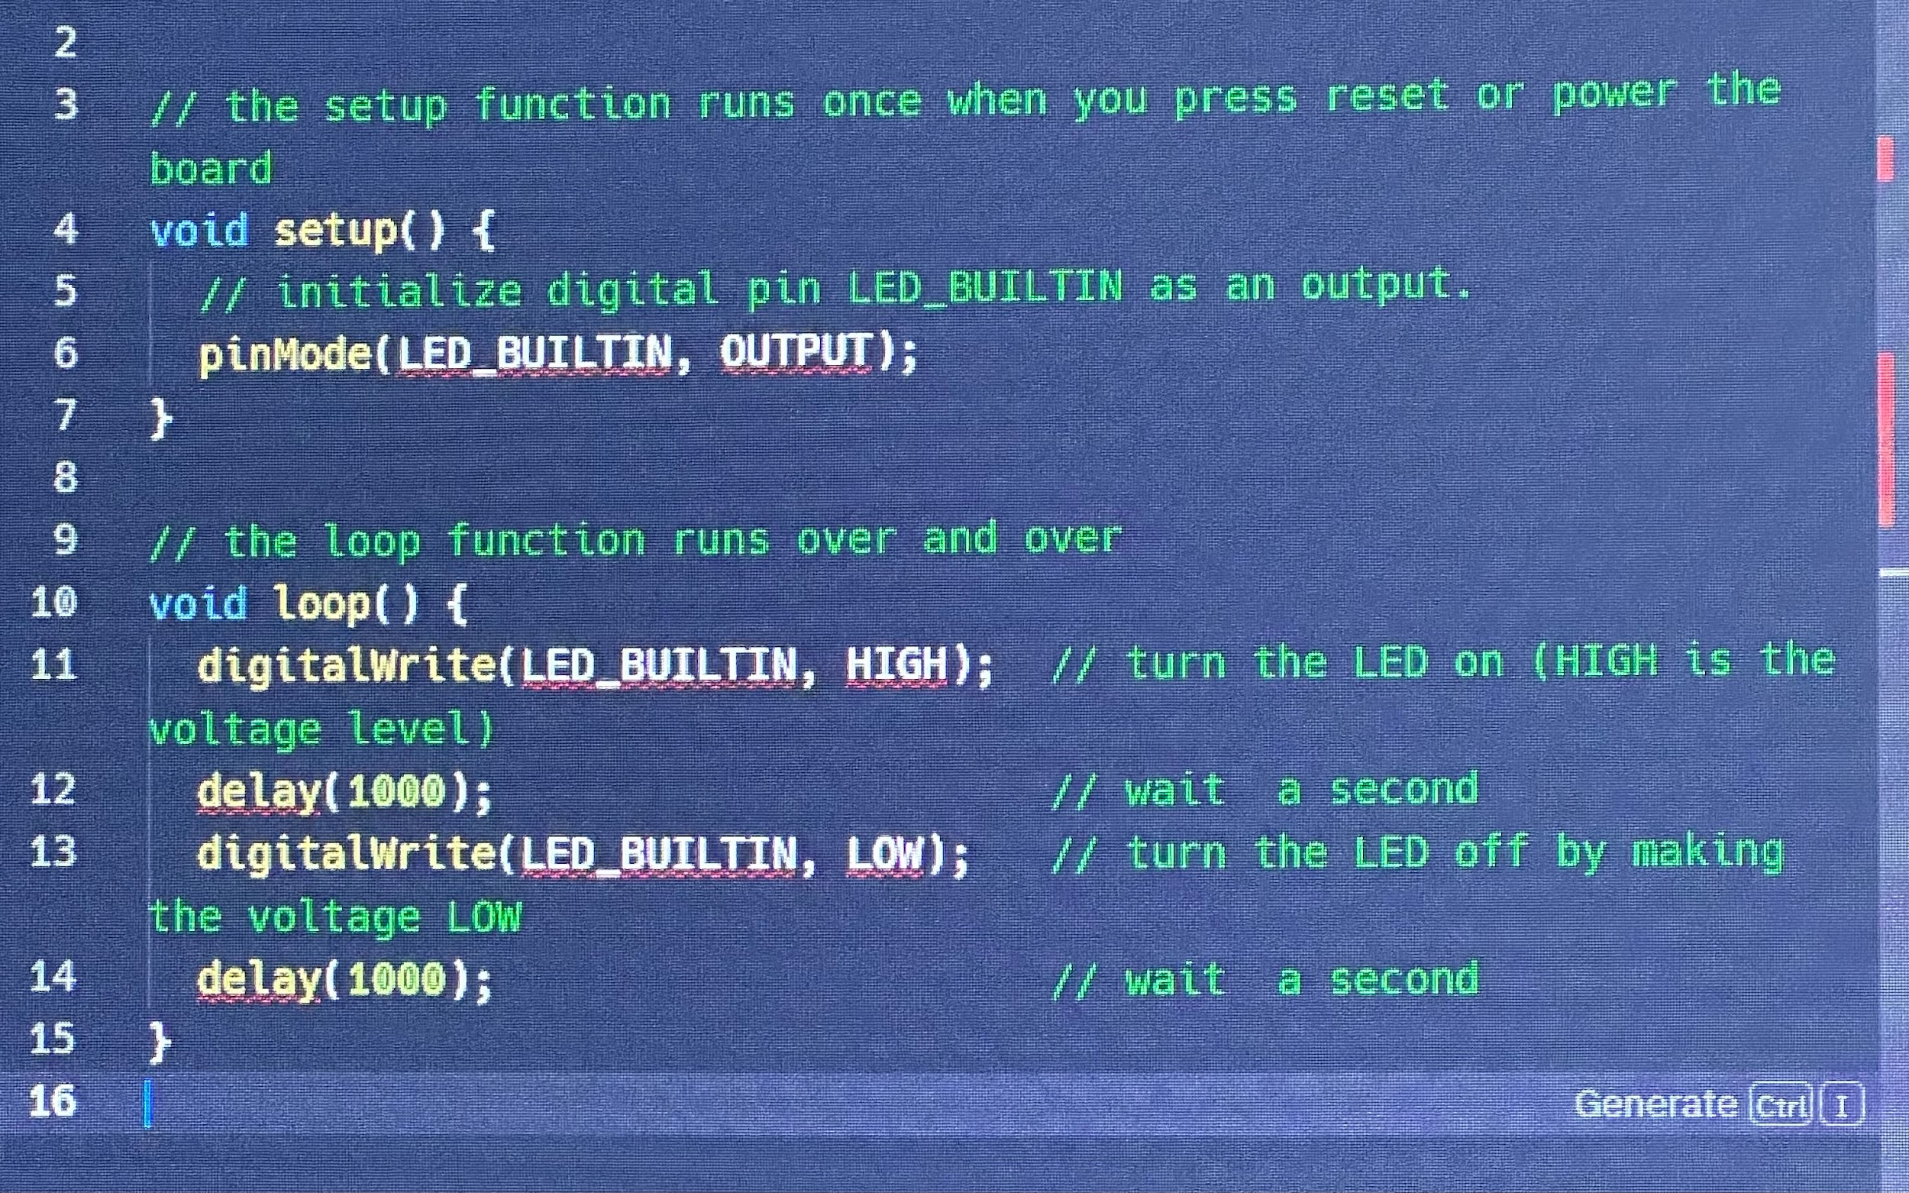
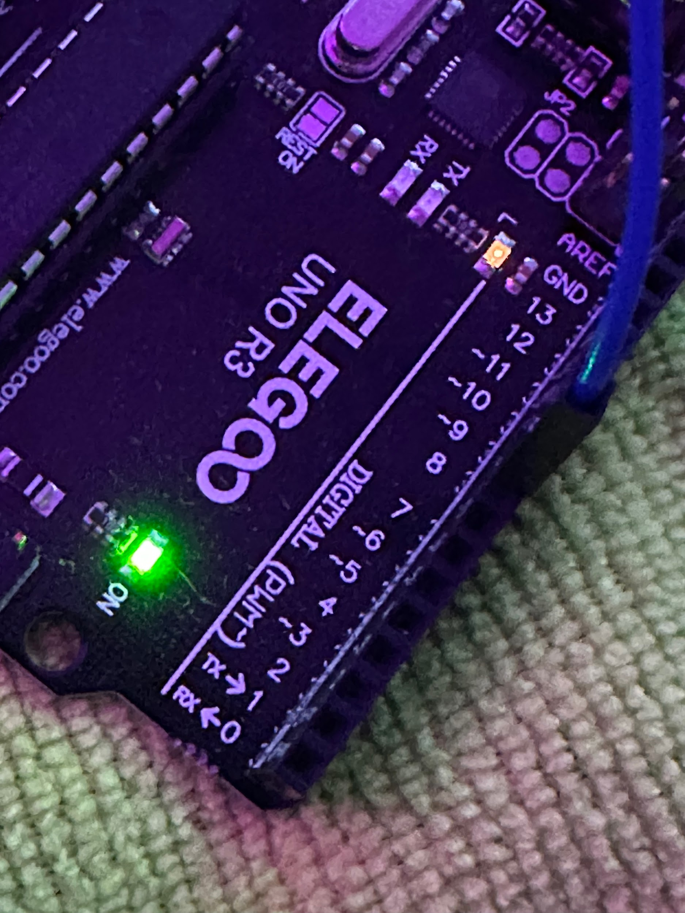
Testing
In the Raspberry Pi-
Through the Arduino IDE- Run
//to see if the raspberry pi is connected to the Arduino controller

Slide 7
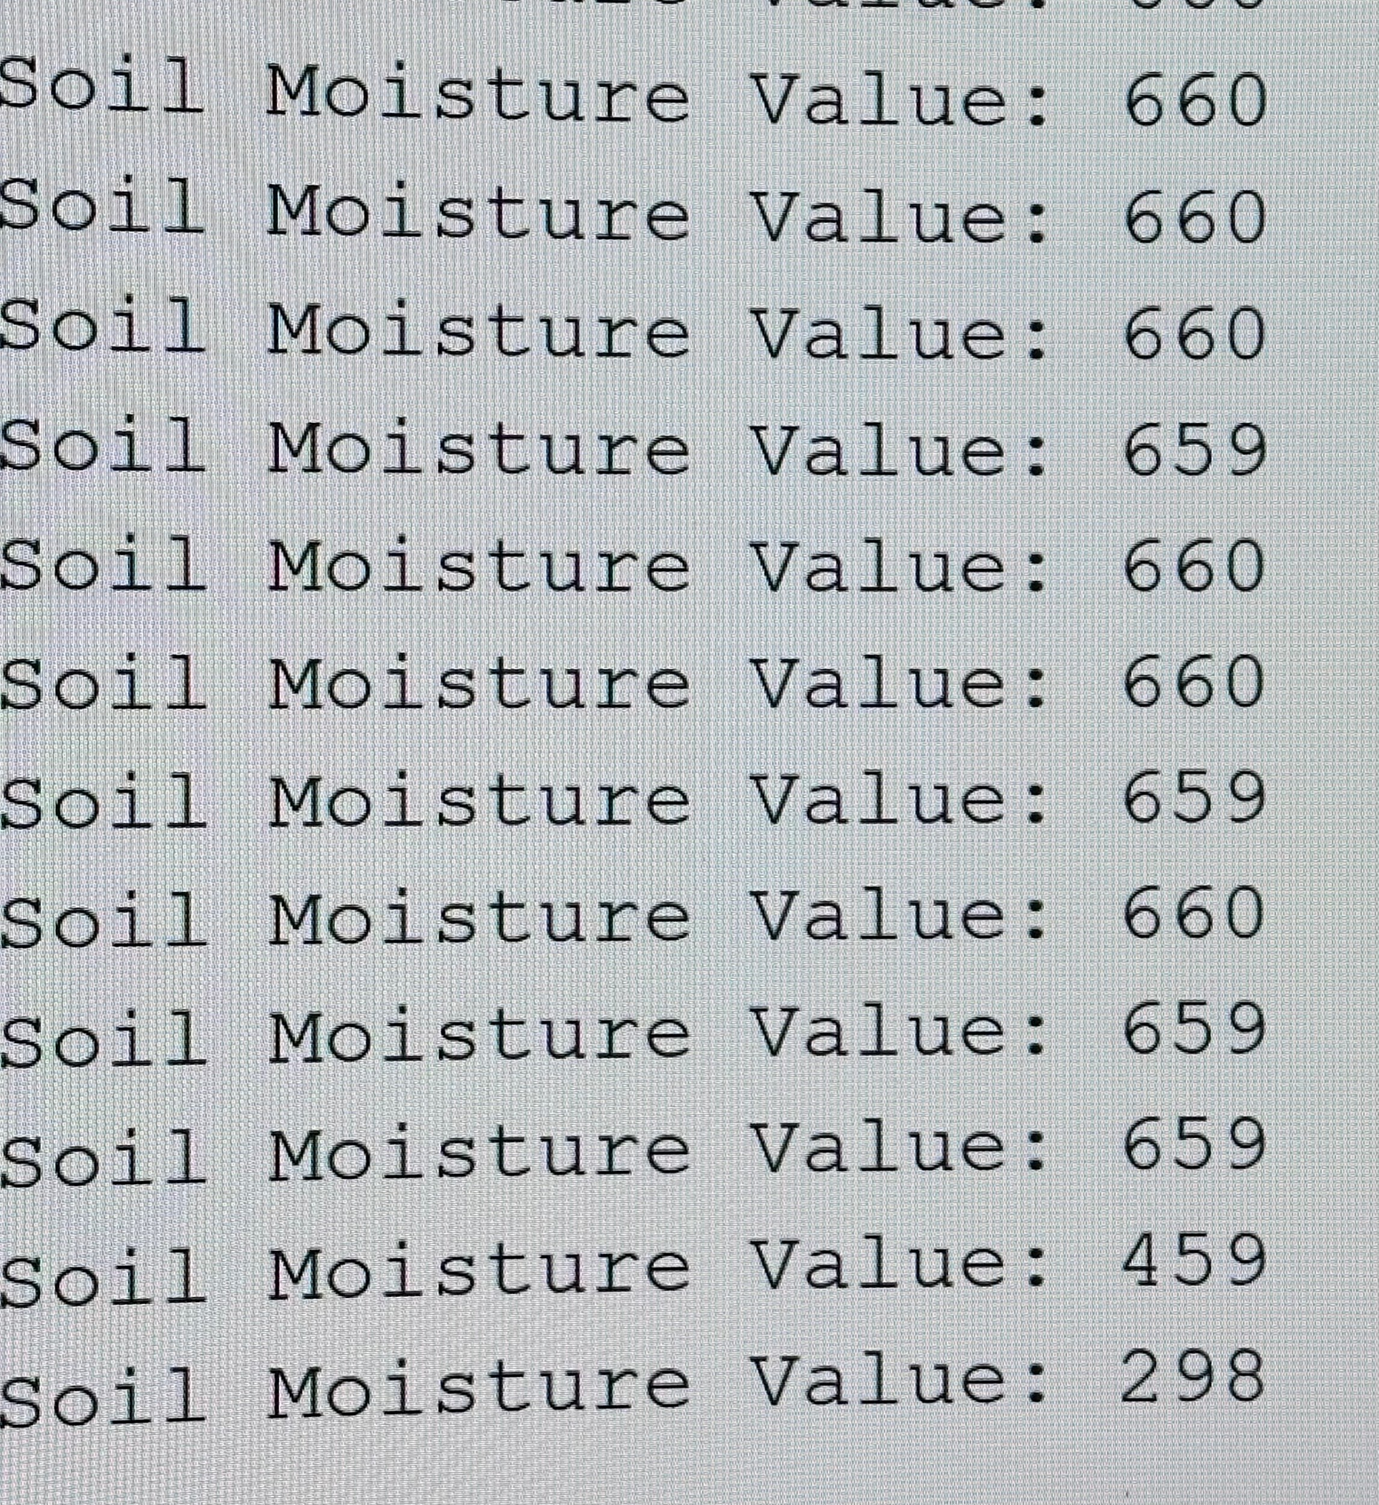
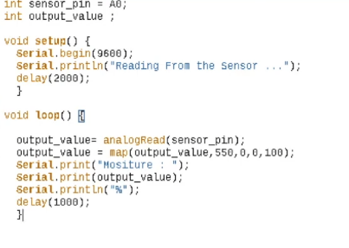
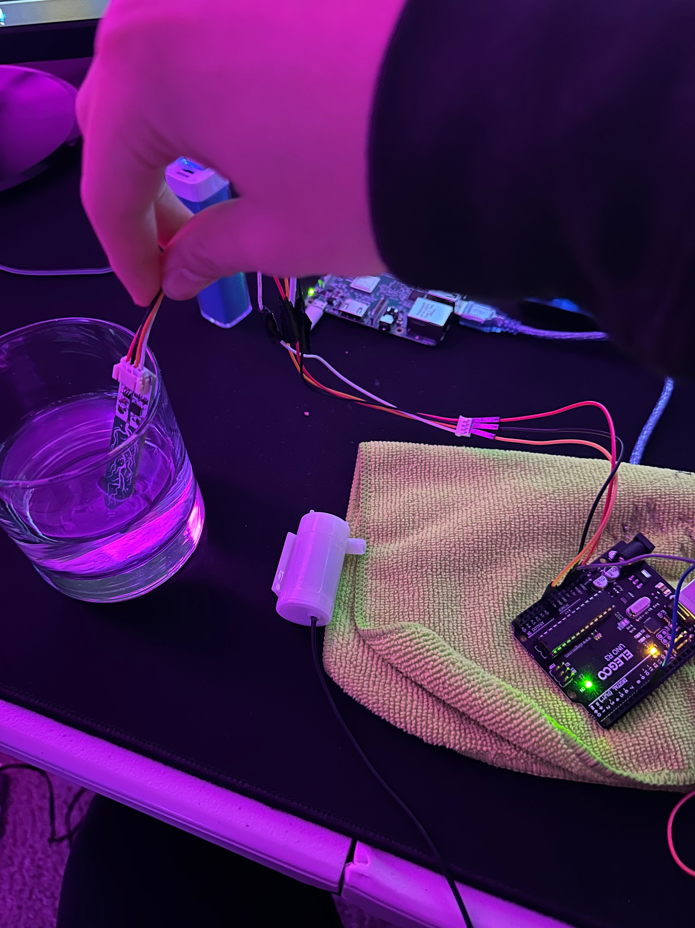
Testing Soil Sensor
Notes:
Most sensors are defective
Should read between 100 but this one eggsagerates readings

Slide 8
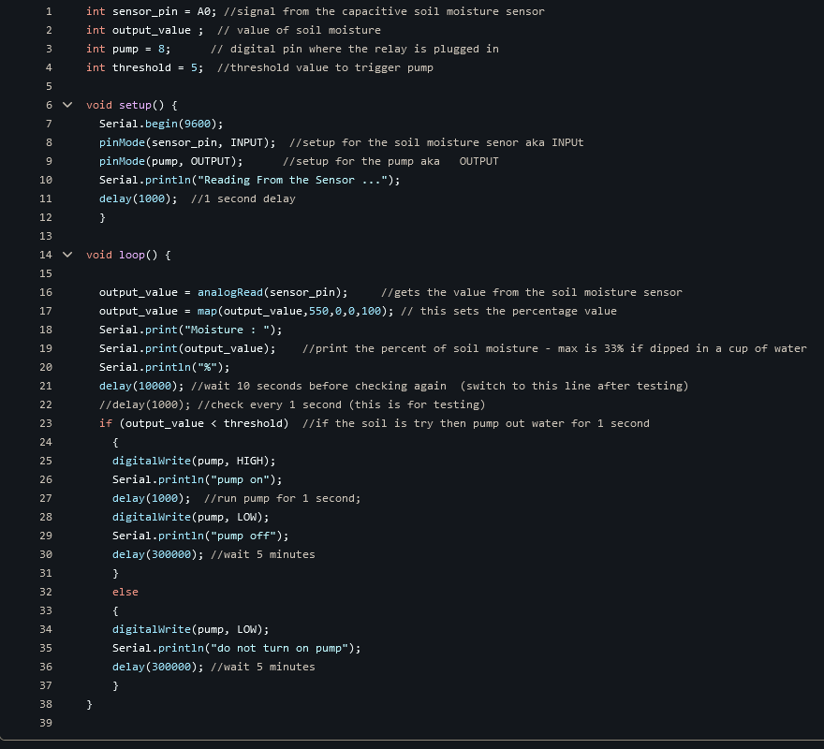
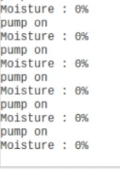
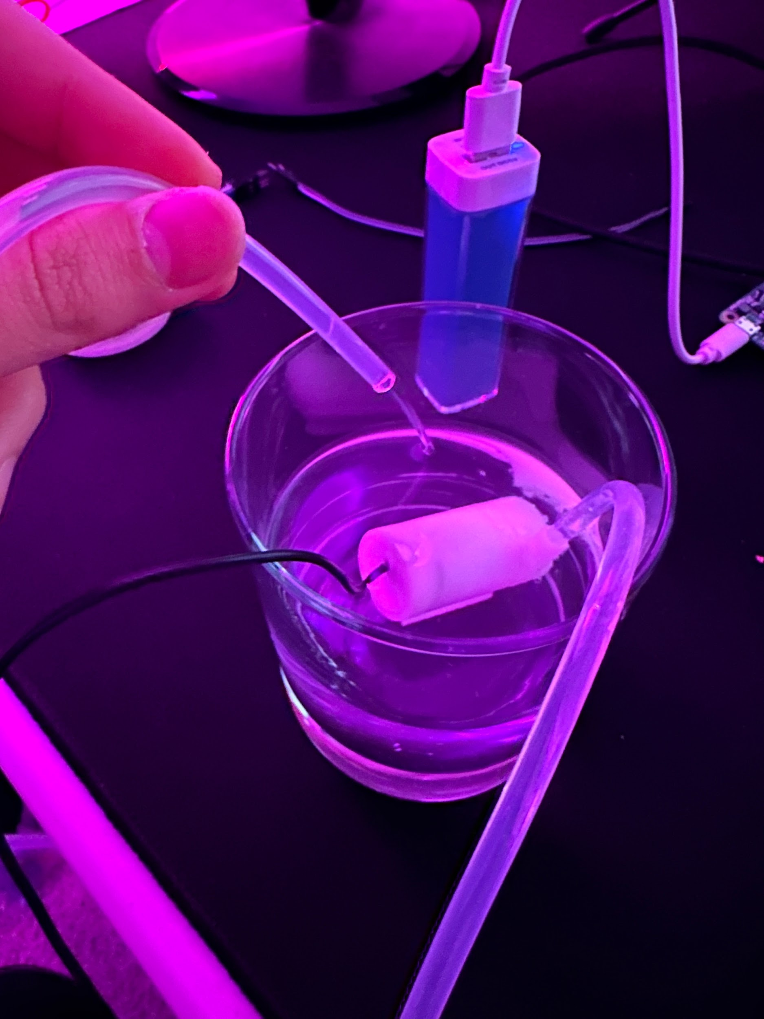
Testing Adjustable Flow Rate
Notes:
Courtesy of @carlinedunn for her experience
water to go off how long and this is
where you kind of can update the code a
little bit so that it works the way you

Slide 9

Final Prototype
Our final prototype ended up meeting all of our design requirements effectively. Our reservoir is 1L and will be easily able to water most plants for over a week. The device can set the moisture level of the dirt to anything desired, and send in as much water that is needed to retain that moisture value.
Reservoir Size
Refill Time
Adjustable Flow Rate/Moisture Level
Maintenance as long as possible
Minimal User Input
Long maintenance period

Slide 10


Sustainability Analysis
Sustainable Engineering Goal 13 “Climate Action”
Efficient energy consumption-low power operation and reducing unnecessary pump operation
Reduced water usage
Climate change adaptation- adjust watering schedules based on change of climate conditions, such as droughts
Sustainable Engineering Goal 15 “Life on Land”
Ecosystem Protection- protects biodiversity by keeping range of plants healthy
Improved soil health
Increased plant CO₂ consumption with increased plant health

Slide 11



Sustainability Analysis cont.
Sustainable Engineering Goal 9 “Industry, Innovation, and Infrastructure”
Technological innovation which can drive economic growth
Production, distribution, and maintenance can create jobs in multiple industries
Sustainable Engineering Goal 11: “Sustainable Cities and Communities”
Green space health- improved air quality
Climate change armor- biodiversity helps cities fight climate change better
Sustainable Engineering 12: “Responsible Consumption and Production”
Efficient resource consumption- optimized water and energy usage minimize environmental impact
Promotes sustainable lifestyle- can encourage people to use more sustainable practices

Slide 12
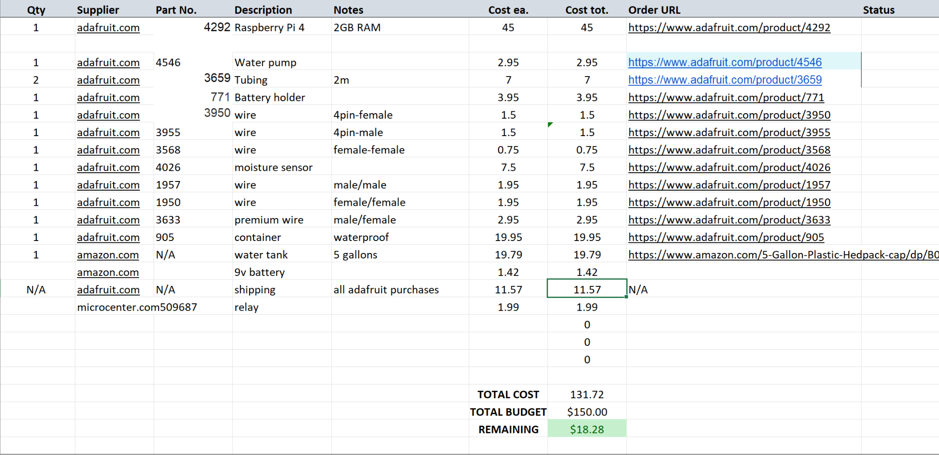
Bill of Materials

Slide 13
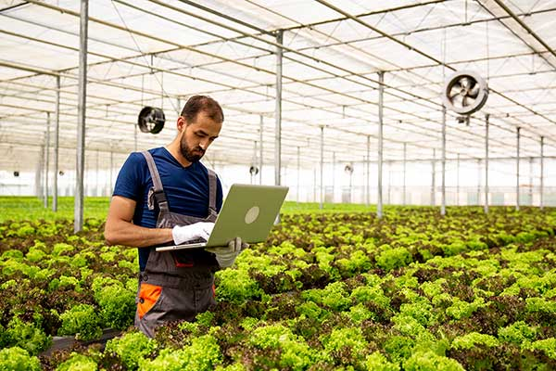
Product Implementation
Greenhouses
Outdoor landscaping
Indoor house plants
Retail stores with large amounts of plants

Slide 14
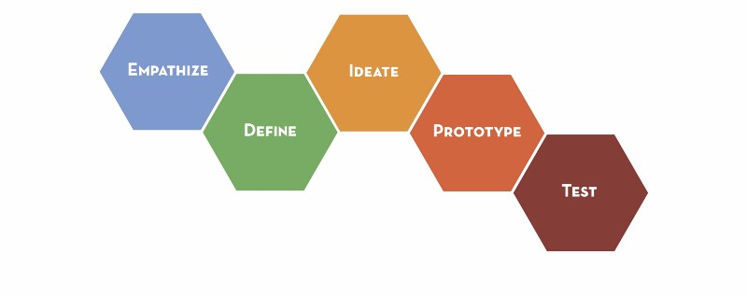
Key Takeaways
Improved working in groups and delegating tasks
Troubleshooting
Problem solving
Communicating effectively
Time management

